Slide 1
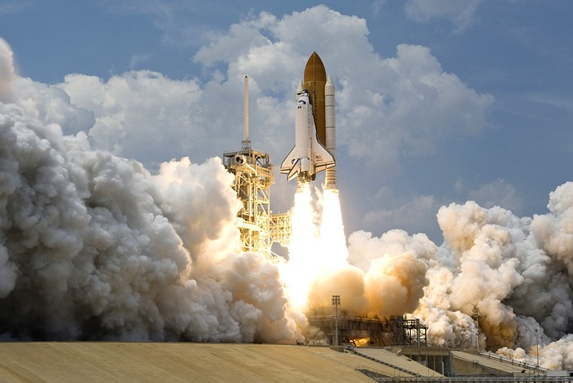






SpaceX Landing Analysis
Michael Dearlove
21 March 2023

Slide 2



OUTLINE
Executive Summary
Introduction
Methodology
Results
Visualizations, Charts
Dashboard Outputs
Conclusion

Slide 3

EXECUTIVE SUMMARY
Data Collection
Data Wrangling
Exploratory Data Analysis with Visualizations
Exploratory Data Analysis with SQL Queries
Interactive Maps and Dashboards
Predictive Analysis and Findings

Slide 4

INTRODUCTION
Project Objective
SpaceX advertises Falcon 9 rocket launches on its website with a cost of 62 million dollars; other providers cost upwards of 165 million dollars each, much of the savings is because SpaceX can reuse the first stage. Therefore if we can determine if the first stage will land, we can determine the cost of a launch. The aim of this project is to produce machine learning insights such that prediction analysis can be made of SpaceX launch successes.
Problems to consider
How successful are SpaceX Falcon 9 launches and how has this changed through time
Which variables are most influential in success and failure
Which machine learning model best predicts the probability of success and to what degree

Slide 5

METHODOLOGY
Data Collection
SpaceX Rest API
Wikipedia Web Scrape
Data Wrangling
Clean and filter data
Transformation and preparation of data for binary classification
Data Exploratory Analysis
Visualizations and SQL derived insights
Interactive analysis with Folium and Plotly Libraries
Predictive Analysis
Build and evaluation of different classification models to determine the best method of launch success prediction

Slide 6
Data Collection
Requests were made to the SpaceX API to extract information using get and request methods. Json responses were converted to Pandas Dataframes. This was filtered to only include Falcon 9 launches.
Wikipedia was utilized to scrape HTML launch information using the Beautiful Soup library and the extracted tables parsed.

Slide 7
Data Wrangling
The Dataframes were filtered, missing values were handled by the use of mean() and replace() functions.
First stage EDA was carried out with data types checked, launch site numbers, orbit types and mission outcomes calculated. A landing outcomes label was created so that binary classification could be used to determine successes.

Slide 8
Exploratory Data Analysis
EDA and feature engineering using Pandas and Matplotlib was performed. Catplots were carried out on Flight number vs Payload and Flight number vs Launch site with markers highlighting outcome.
The relationship between Payload and Launch site was then analysed, followed by Success rate and Orbit type.
Flight number vs Orbit type and Payload vs Orbit type were then plotted and the yearly success trend generated.

Slide 9
Features Engineering and Predictive Analysis
Preliminary insights were gained from this EDA and the most relevant features to success prediction isolated.
Dummy variables to categorical columns were implemented and all numeric columns were cast to data type float64 ready for next stage analysis.
Predictive analysis was carried out using various machine learning algorithms to ascertain the best predictive model

Slide 10
SQL Analysis
Further understanding of the SpaceX dataset was carried out using SQL queries within the Python notebook via a database connection.
Extracted data included total and average payload mass, notable dates, names of boosters based on launch site and payload criteria and numbers of successful landings between certain time periods.

Slide 11
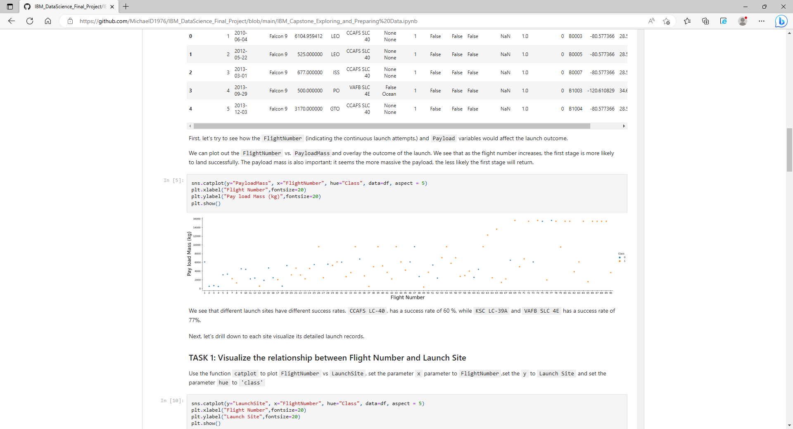
Results
Flight number vs Payload Mass vs Outcome
- We saw how there is a trend between flight number and steadily increasing Payload

Slide 12
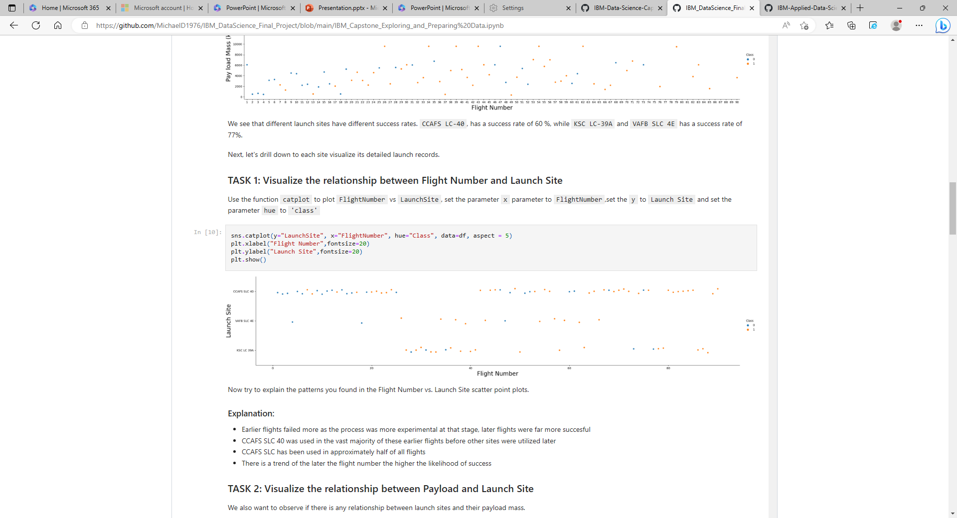
Flight Number vs Launch Site vs Outcome
- We found that certain launch sites were used more frequently and that successful outcomes were more likely with most recent launches.

Slide 13
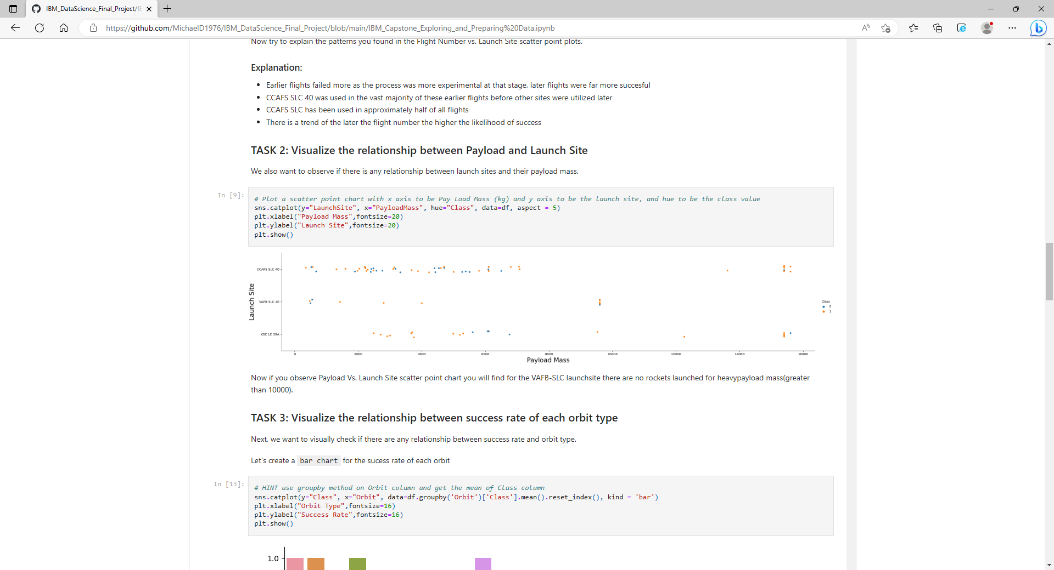
Payload vs Launch Site vs Outcome
- We see how different launch sites have been used given varying Payloads

Slide 14
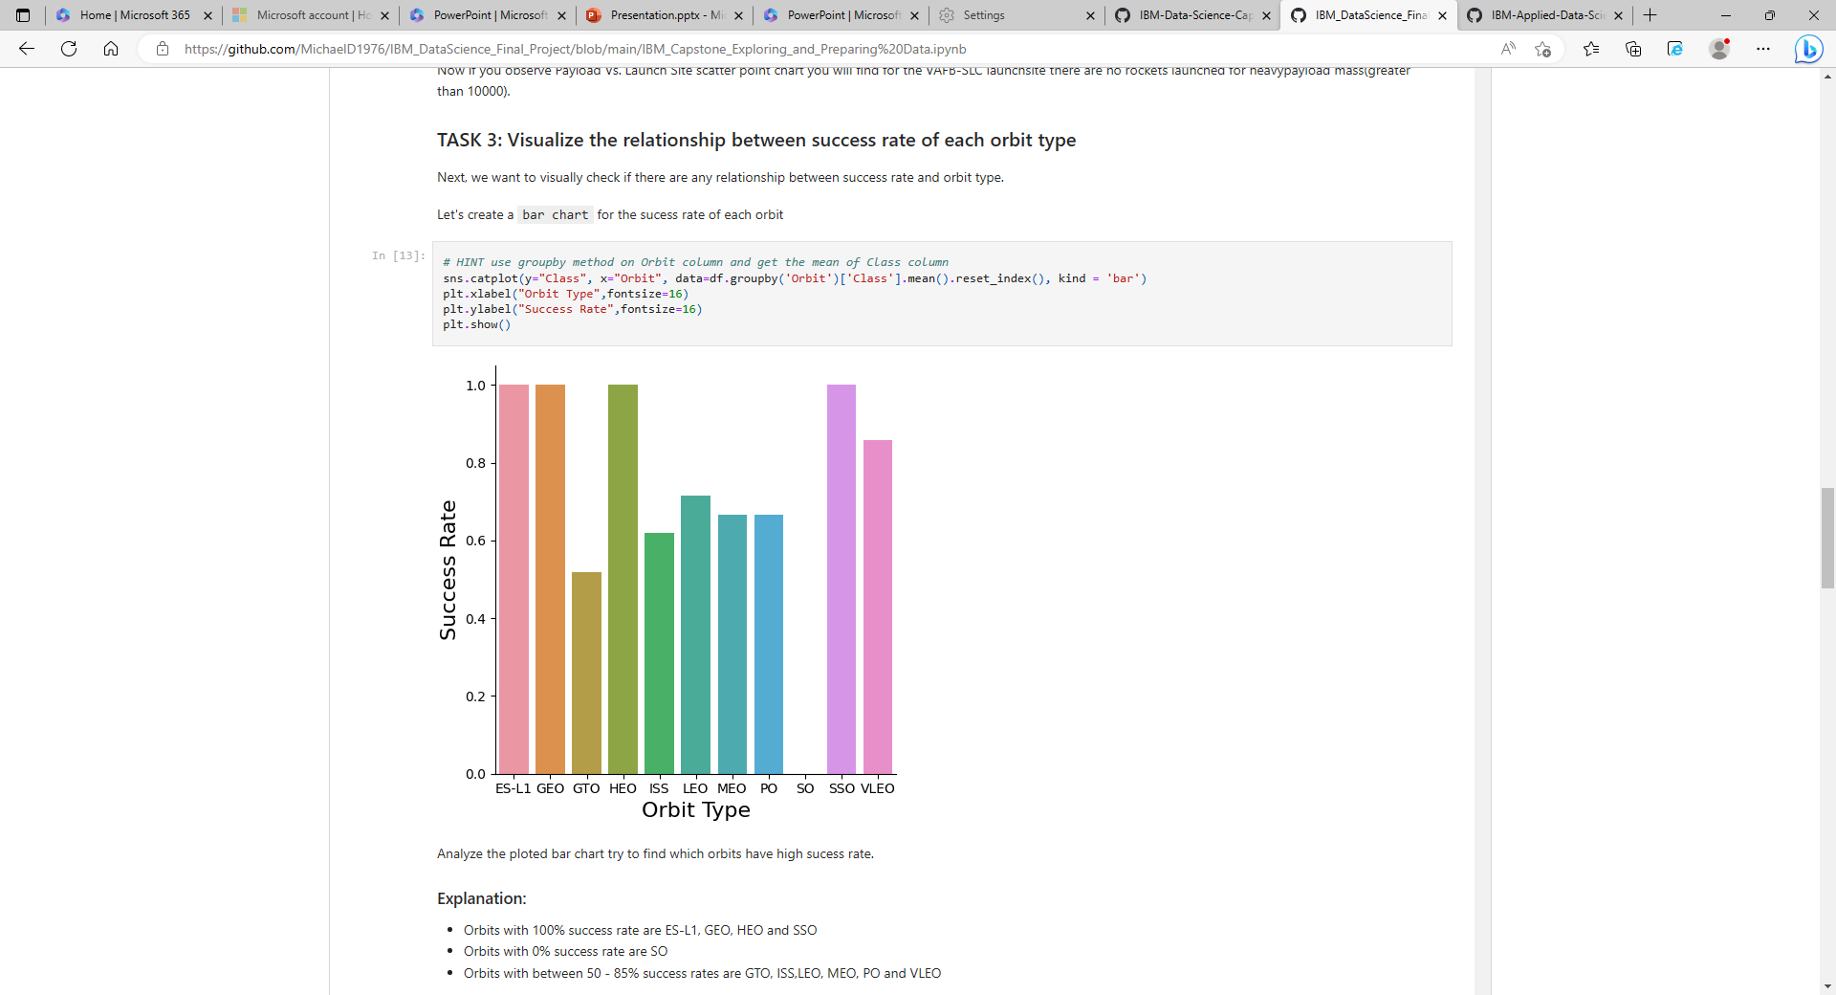
There was some variation between orbit types and success rates.

Slide 15
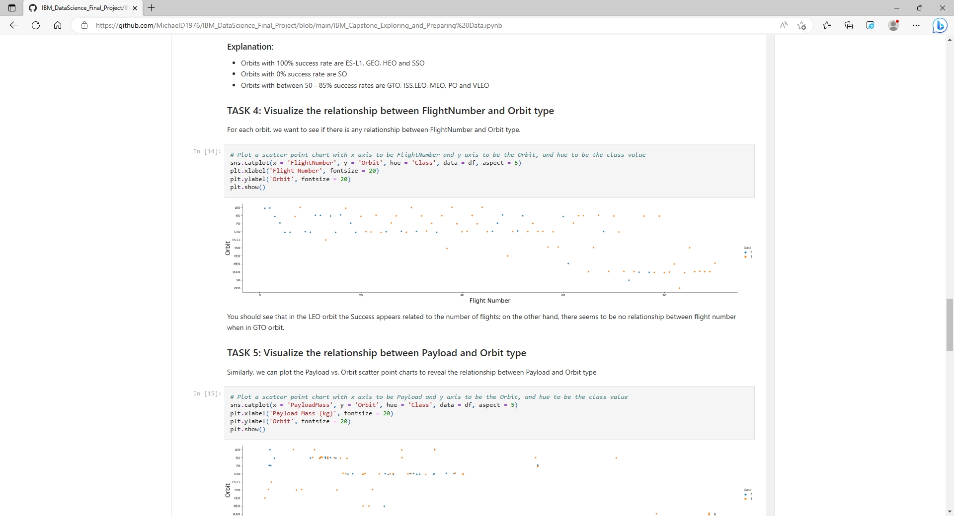
Flight Number vs Orbit type vs Outcome
- More Orbit types have been trialled as more flights carried out

Slide 16
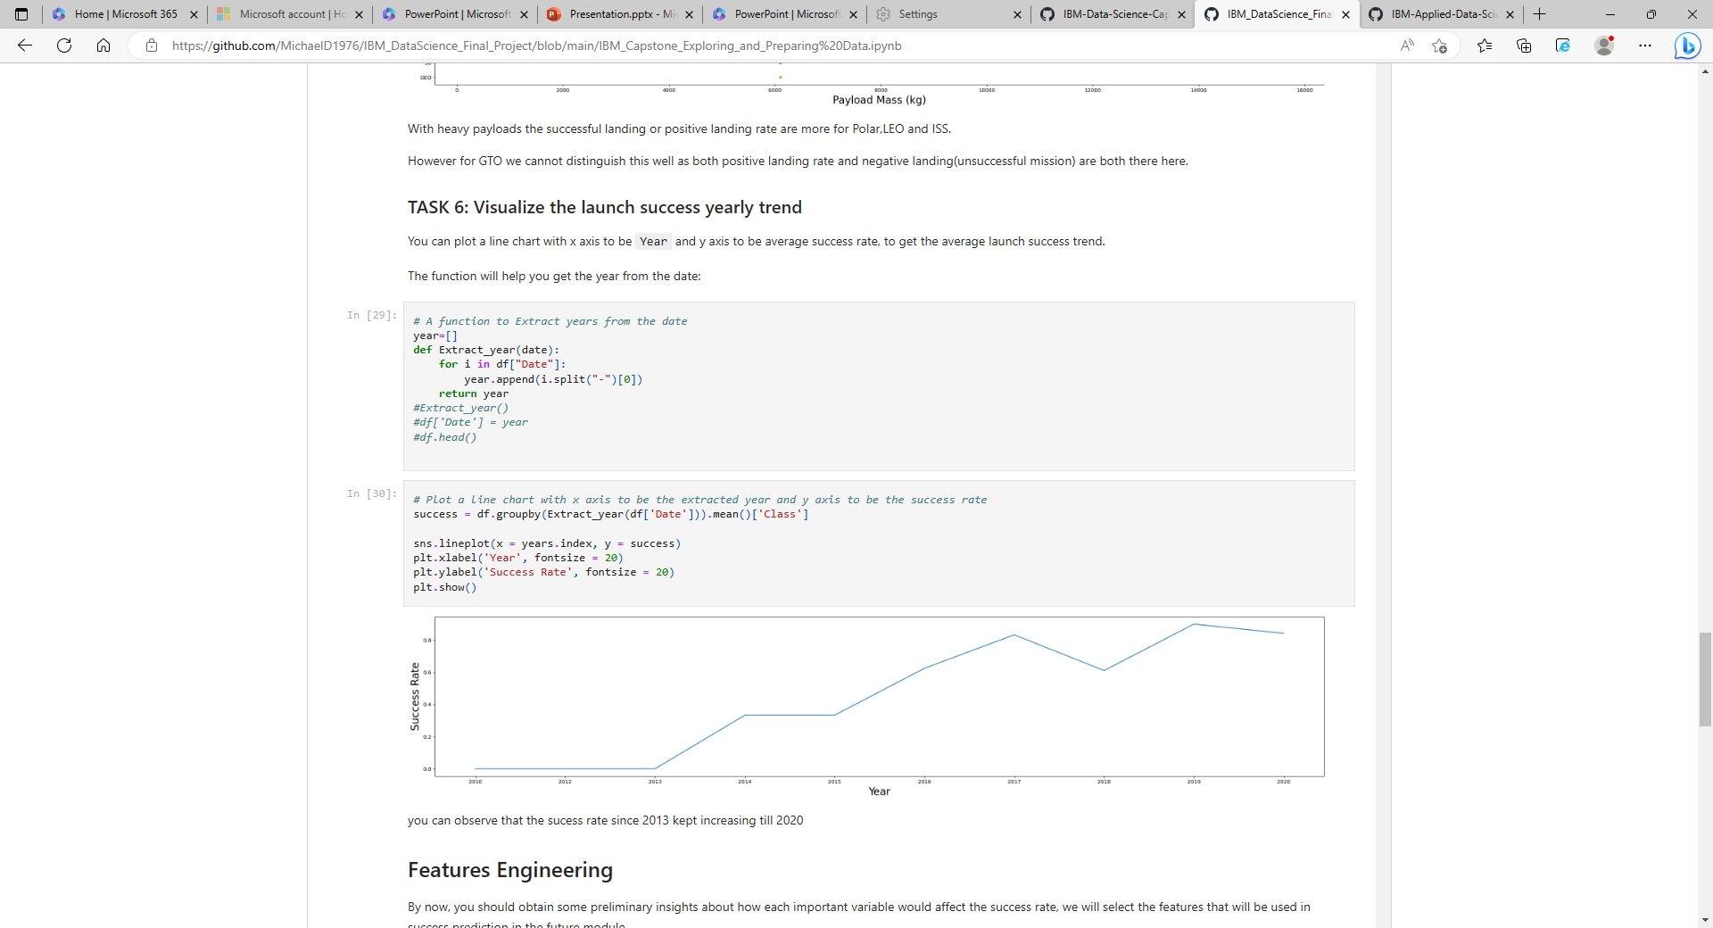
There is a clear trend of increasing rocket launch success with time

Slide 17
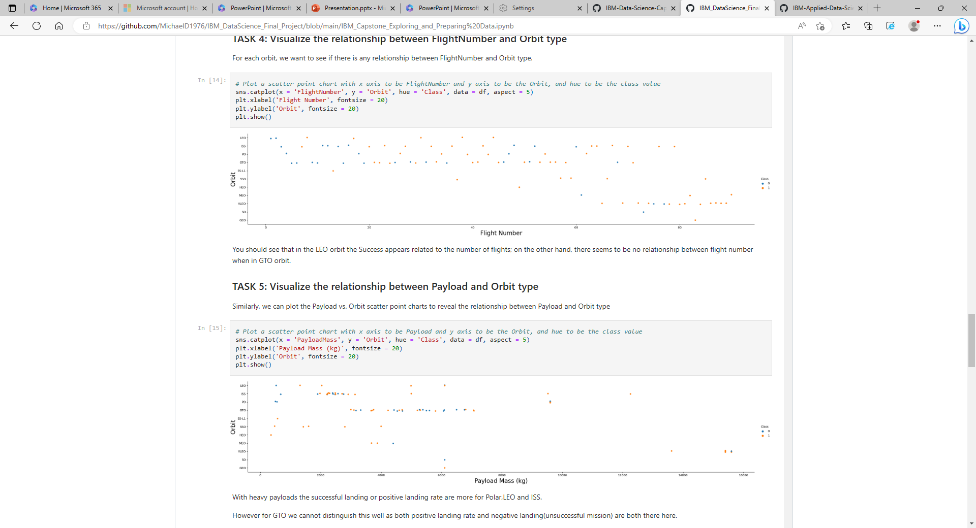
There is a clear relationship between Payload and Orbit Type

Slide 18
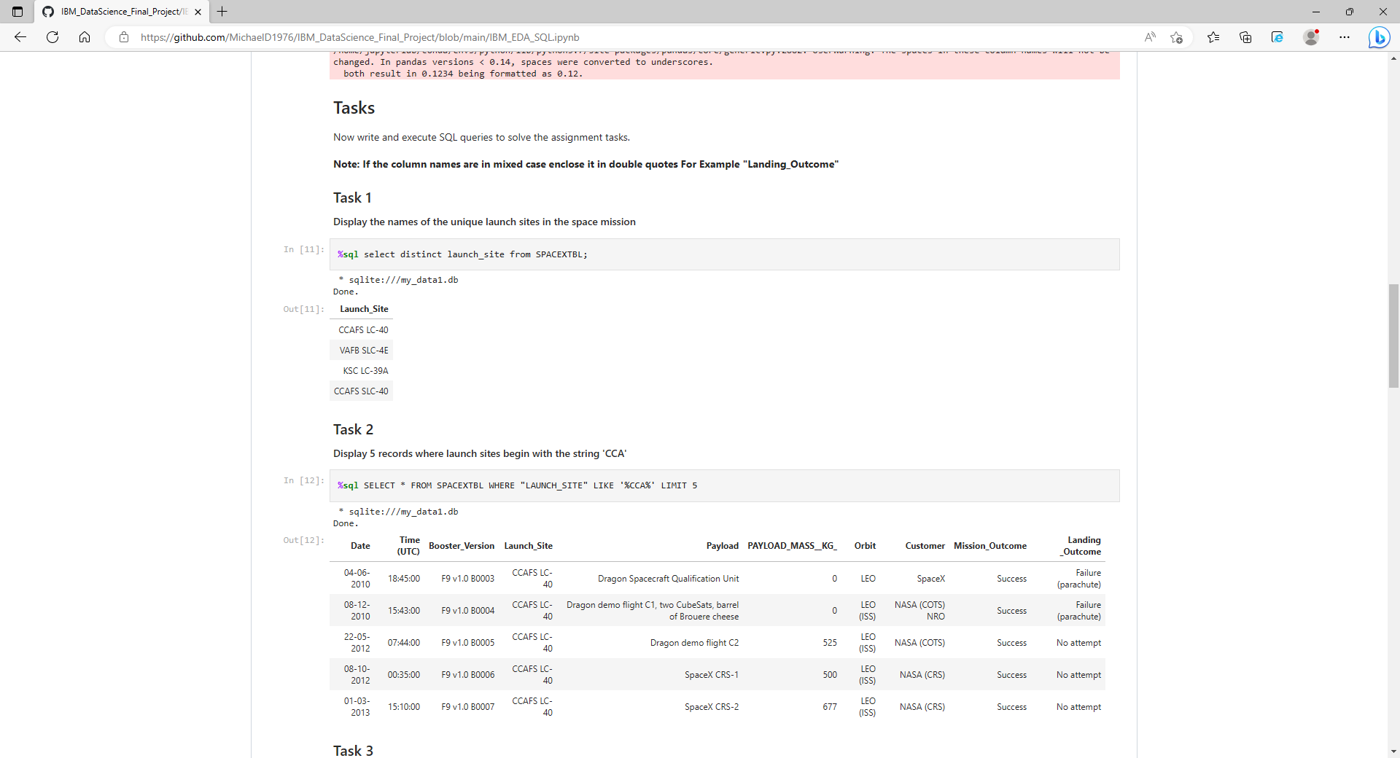
SQL was used to query unique launch sites used

Slide 19
SQL was used to select launch site ID’s which commenced with string structure ‘CCA’

Slide 20
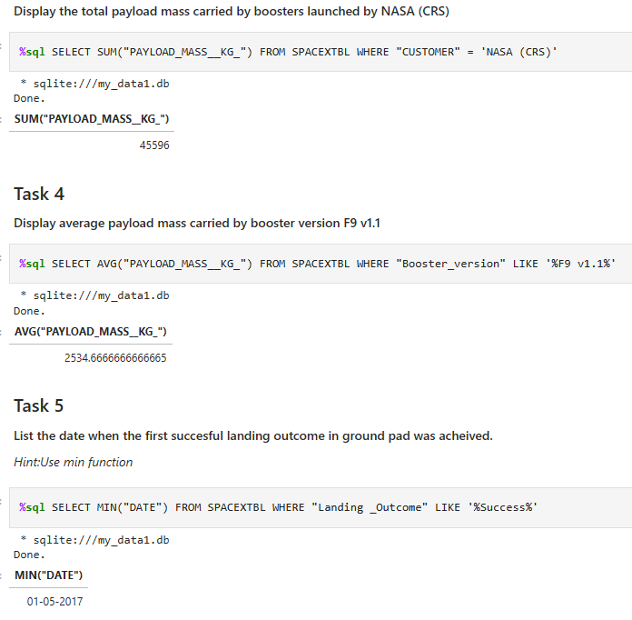
SQL used to display:
Total Payload mass launched by NASA (CRS)
Average Payload mass carried by booster F9 v1.1
The date of the first successful landing outcome

Slide 21
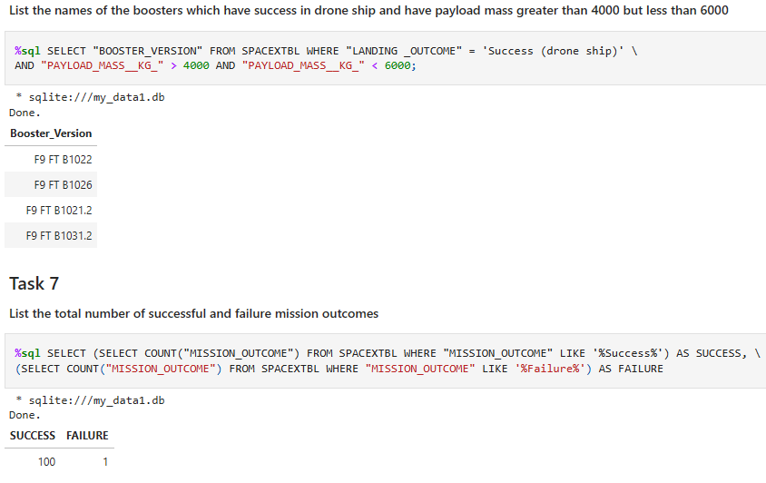
SQL used to display:
Names of boosters with success in drone ship and have Payload between 4000 and 6000 kg
Total successes/failures of missions

Slide 22
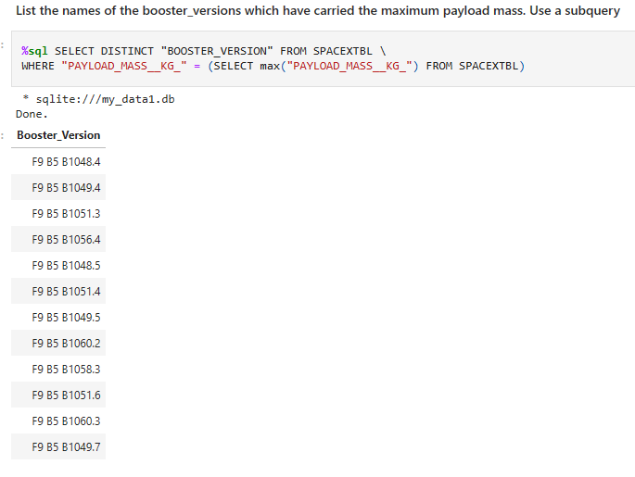
SQL used to display the names of the booster versions which have carried the maximum payload mass

Slide 23
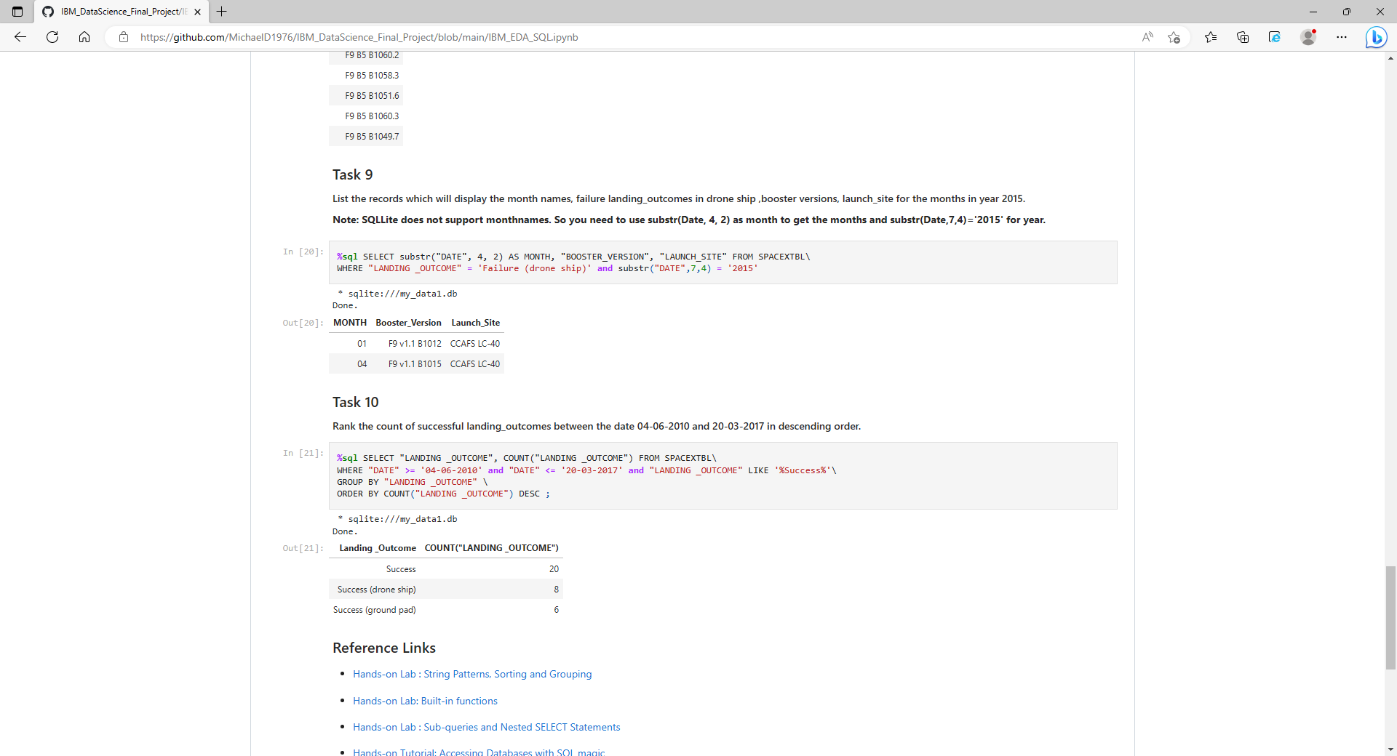
SQL used to:
List the records which display the month names, failure landing outcomes in drone ship, booster versions and launch site for the months of 2015
Rank the count of successful landing outcomes between 4-6-2010 and 20-03-17

Slide 24

Launch site visualizations using Global Map Markers

Slide 25
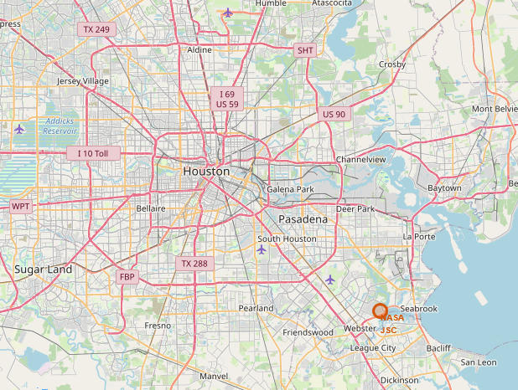
A Folium Map Object was generated with an initial centre location of NASA Johnson Space Centre, Houston

Slide 26
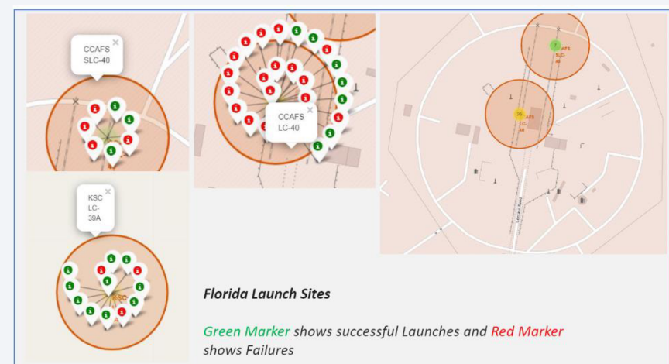
A circle was added for each launch site

Slide 27
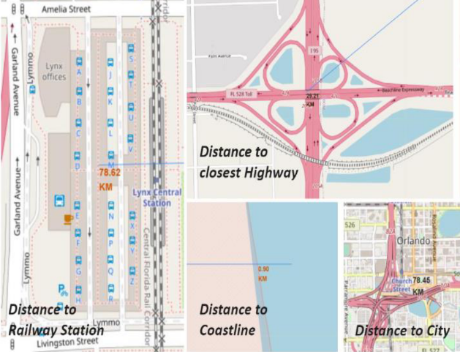
Distances to road, rail, city and coastline were assessed

Slide 28
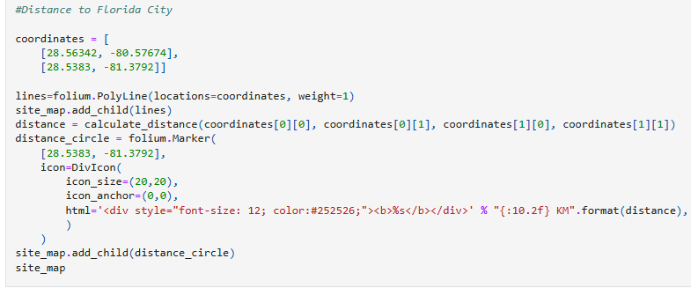
The function map.add_child() was utilized to add folium map markers
The distances calculated from launch pad to landmarks showed that launch sites were not located close to railways, highways or cities, but were all close to the coastline.

Slide 29
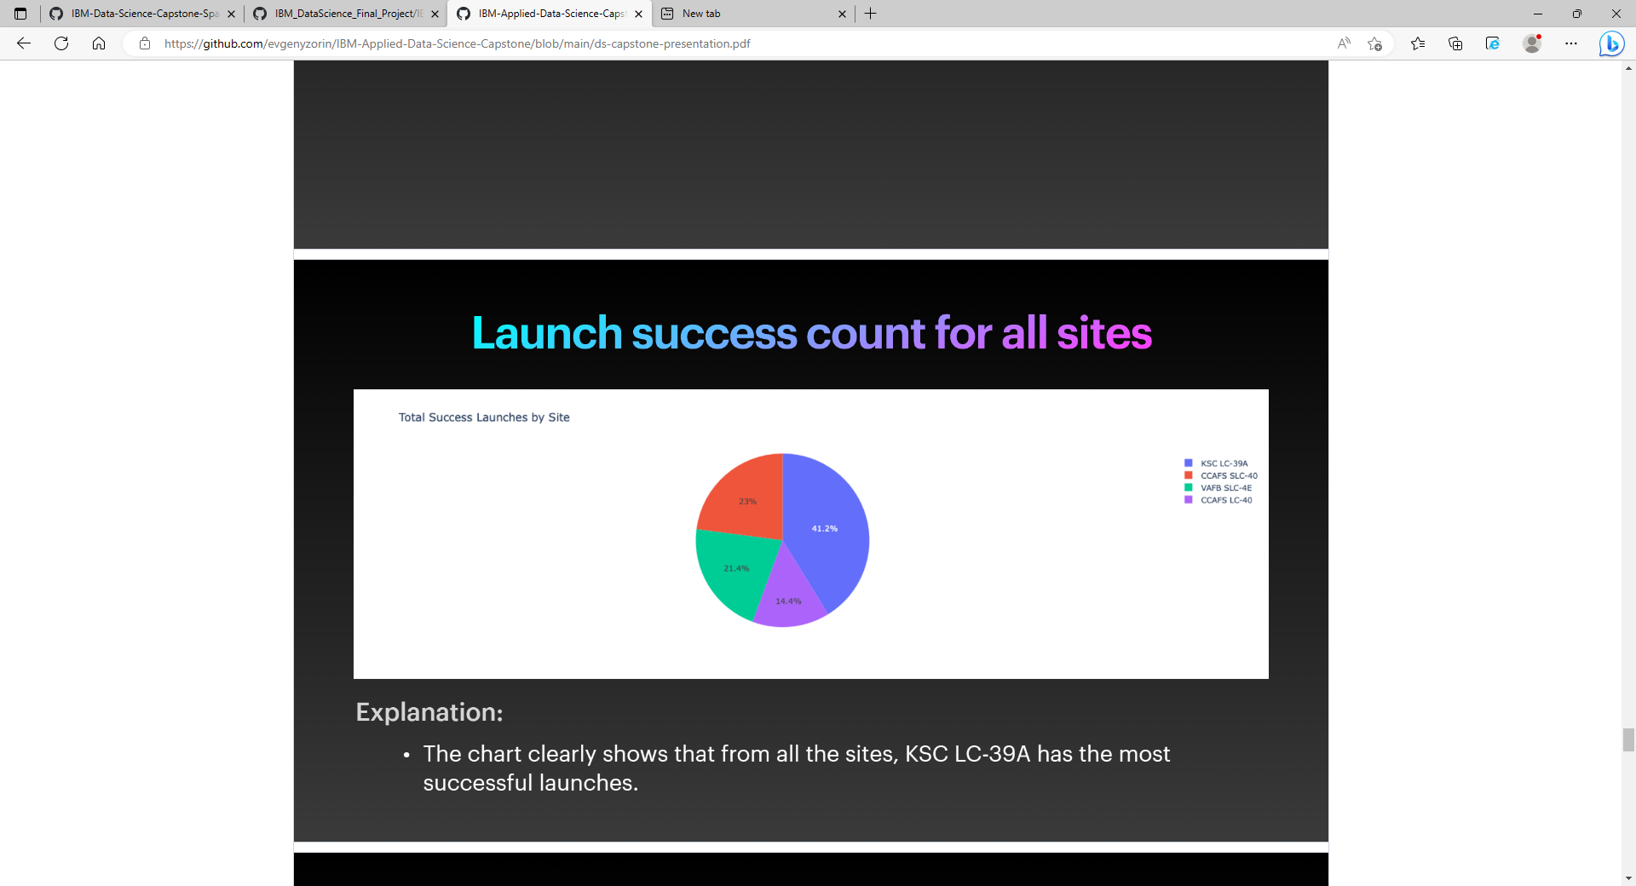
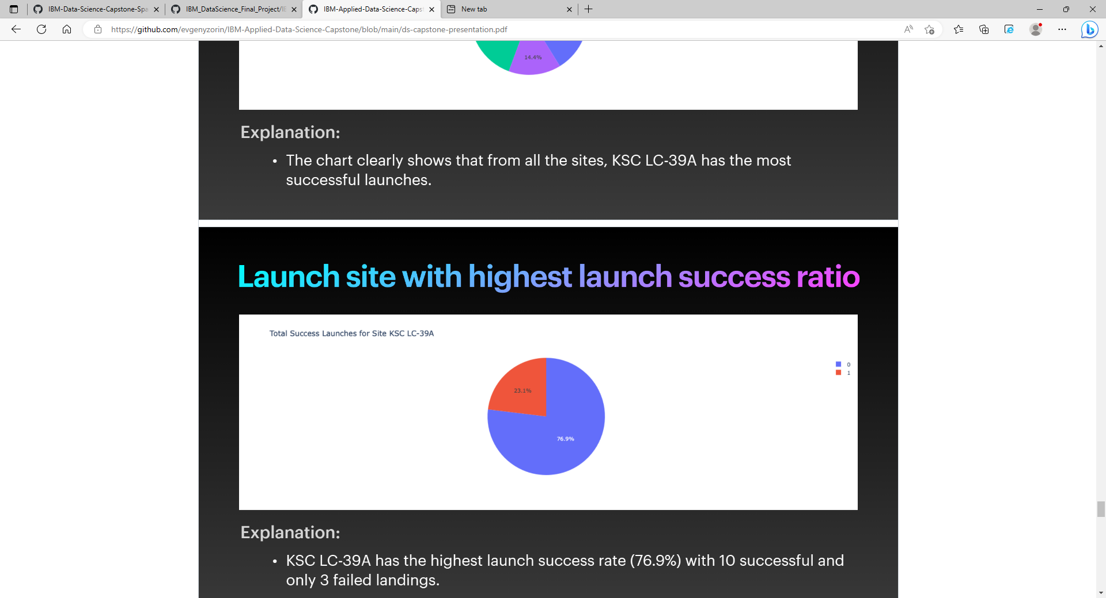
Dashboard Pie Charts Visualizations
Total successful launches by site
Total success launches for specific site KSC LC-39A

Slide 30
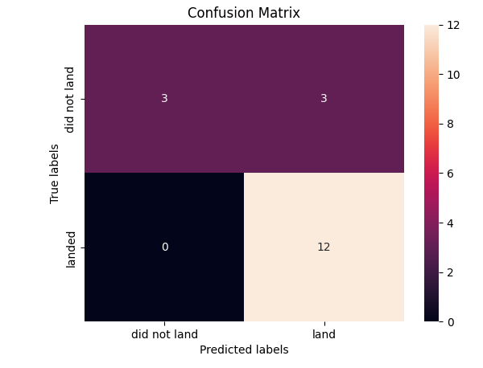
Predictive Analysis
Four classification models were built and tested. The data was initially standardized and split into training and test data. Accuracy of each model was assessed and Confusion Matrices generated
Confusion Matrix utilized
- Here we see that for logistic regression, it can distinguish between different classes but that the major problem is false positives

Slide 31
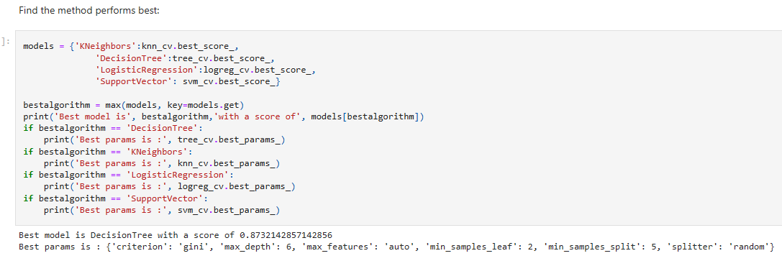
Which Model performed best?
Summarising the classification models tested, we can see that the Decision Tree model scored best (0.873) with the best given parameters

Slide 32
Conclusions
The Decision Tree Model proved to be the best predictor of launch success on this dataset
Orbits ES-L1, GEO, HEO and SSO were the most successful
The probability of launch success has increased after each subsequent previous launch
Launches with lighter Payload mass have had higher probabilities of success
KSC LC-39A has had the best rate of success from all launch sites

Slide 33


